Slide 1




The Reach Profiler (REAPER): Enabling the Mitigation of DRAM Retention Failures via Profiling at Aggressive Conditions
Minesh Patel Jeremie S. Kim
Onur Mutlu
Notes:
Hi, I’m Minesh Patel from ETH Zurich
and today, I’ll talk about the reach profiler, a new methodology for DRAM retention failure profiling

Slide 2
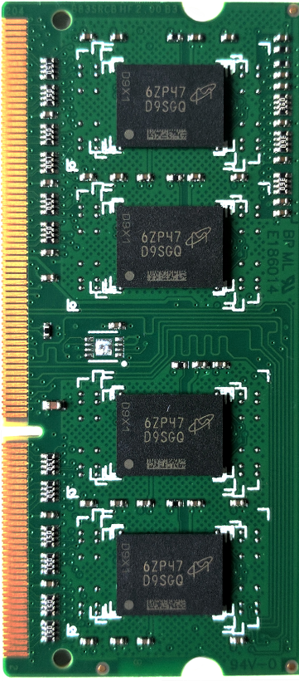
Leaky
DRAM
Row Decoder
SA
SA
SA
SA
SA
Notes:
DRAM is composed of a heterogeneous set of cells with various different leakage rates

Slide 3
Leaky Cells
Periodic DRAM Refresh
Performance + Energy Overhead
Notes:
This requires a process called DRAM refresh in order to periodically restore charge to the leaky cells
However, this results in significant system performance and energy penalties.

Slide 4
Goal: find all retention failures for
a refresh interval T > default (64ms)
Row Decoder
SA
SA
SA
SA
SA
Notes:
Ideally, we would like to identify all the cells that fail at a given refresh interval so that we can extend the default refresh interval past 64ms and mitigate DRAM refresh overhead

Slide 5
Process, voltage, temperature
Variable retention time
Data pattern dependence
Notes:
However, there are a number of unwanted effects that complicate profiling, which I will go into in detail in my talk later this afternoon

Slide 6
Characterization of
368 LPDDR4 DRAM Chips
1
Cells are more likely to fail at an
increased (refresh interval | temperature)
2
Complex tradeoff space between profiling
(speed & coverage & false positives)
Notes:
In order to better understand these effects in modern DRAM, we perform the first extensive characterization of 368 LPDDR4 DRAM chips
We make two major observations
First, we find that cells are more likely to fail at an increased refresh interval or temperature
Second, we identify a complex tradeoff space surrounding profiling, and characterize it in terms of profiling speed, failure coverage, and false positive rate

Slide 7
temperature
operate
here
refresh interval
Notes:
We leverage these observations to develop the reach profiler, which searches for failures NOT at the operating conditions,

Slide 8
REACH
PROFILING
profile
here
temperature
operate
here
refresh interval
Notes:
But rather at reach conditions, where cells are more likely to fail

Slide 9
Reach Profiling
A new DRAM retention failure profiling methodology
+ Faster and more reliable
than current approaches
+ Enables longer refresh intervals
Notes:
We find that this not only increases profiling speed and reliability beyond prior approaches to profiling,
But also enables longer refresh intervals that were previously unreasonable due to profiling overhead

Slide 10
The Reach Profiler (REAPER): Enabling the Mitigation of DRAM Retention Failures via Profiling at Aggressive Conditions
Session 4A, 4-5:40pm
Minesh Patel Jeremie S. Kim
Onur Mutlu
Notes:
Thank you, and please come to my talk this afternoon.

